Slide 1
Catholic Schools Week Winter 2023-2024

Slide 2
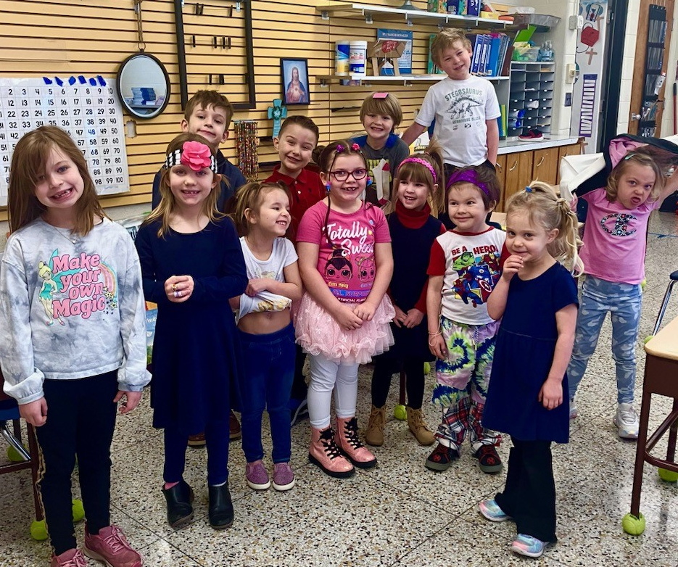
Catholic Schools Week January 28 – February 2, 2024
Crazy Clothes & Hair Day!

Slide 3
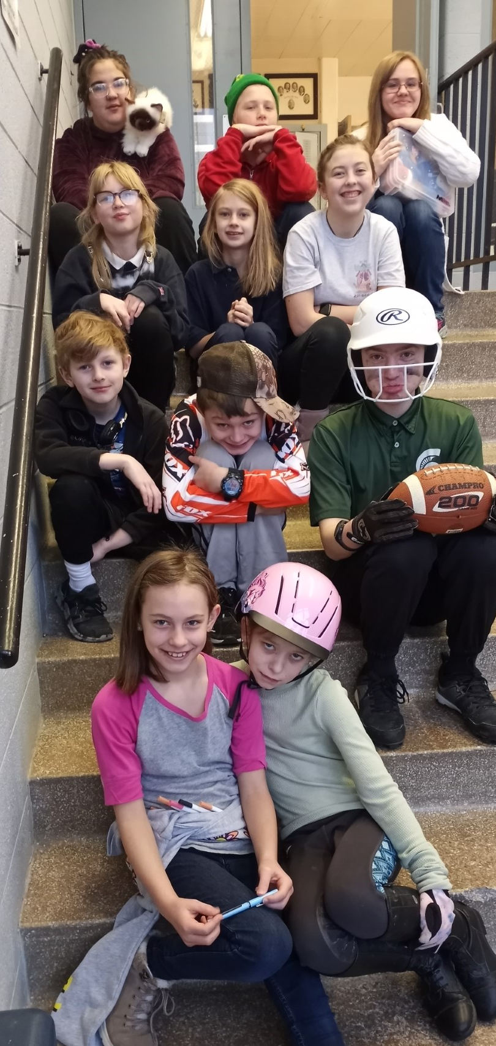
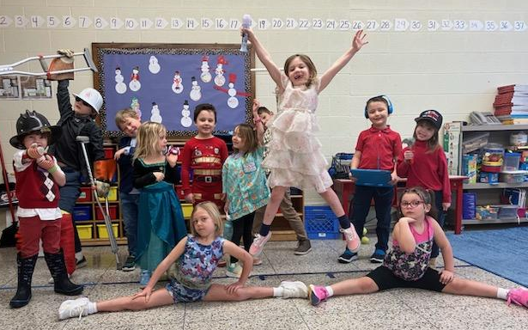
Dress as your future self!

Slide 4
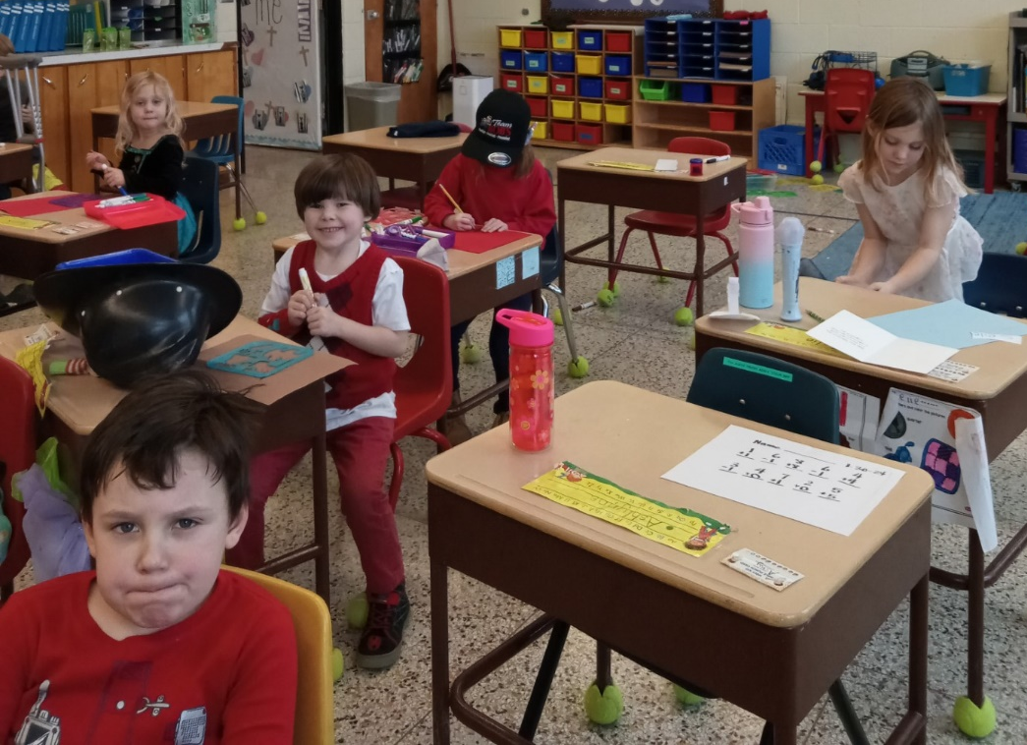
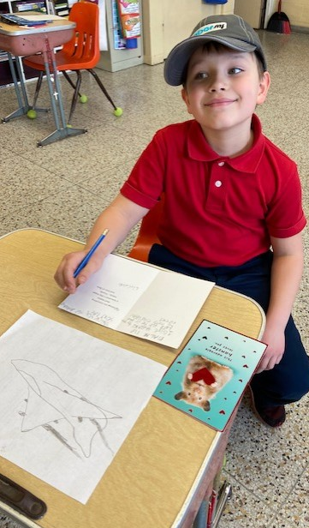
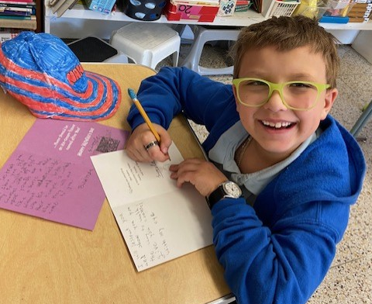
Making Cards for Veterans, Nursing Home Residents & our Seminarians!

Slide 5
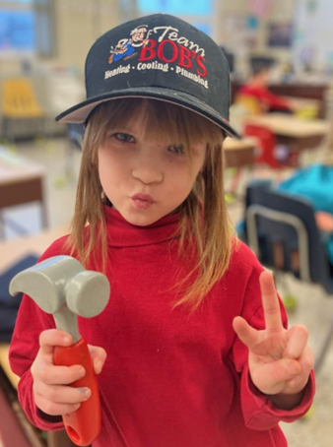
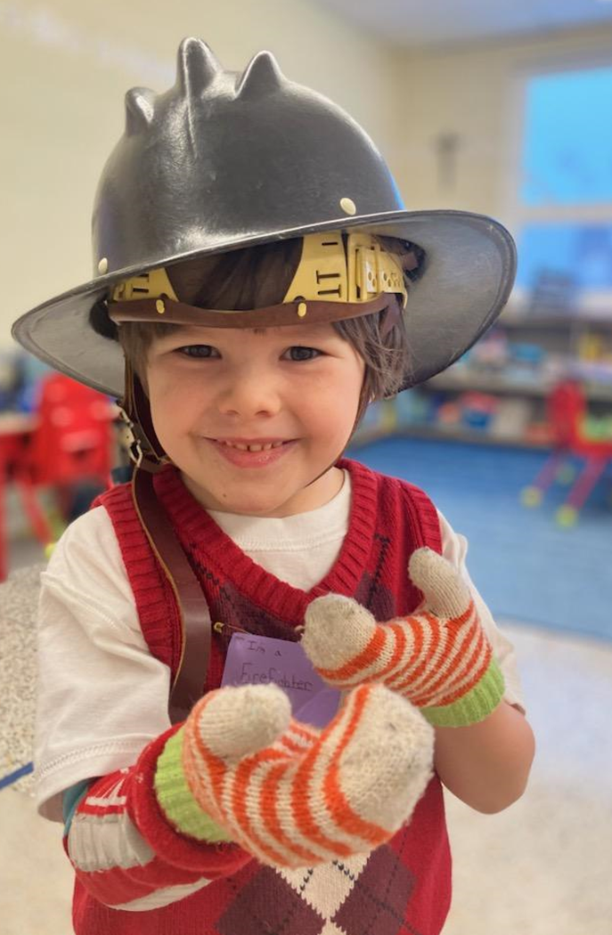
HATS!!!!

Slide 6
Crazy Hat & Socks Day!

Slide 7
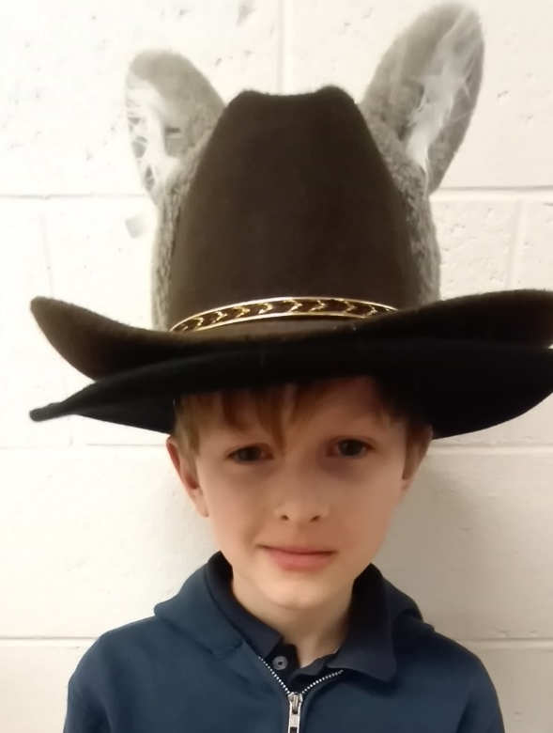
MORE Crazy Hats & Socks!

Slide 8
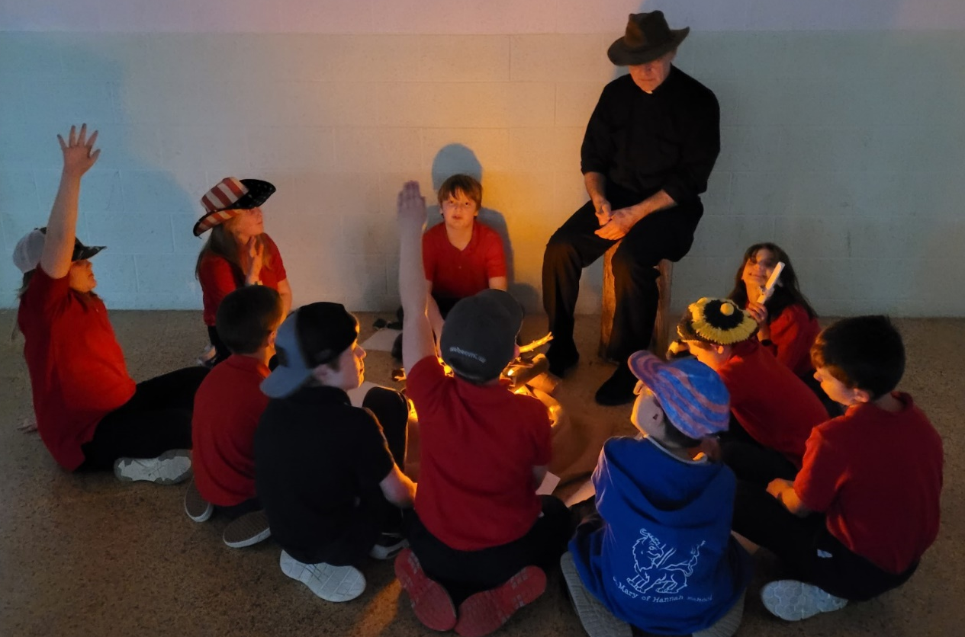
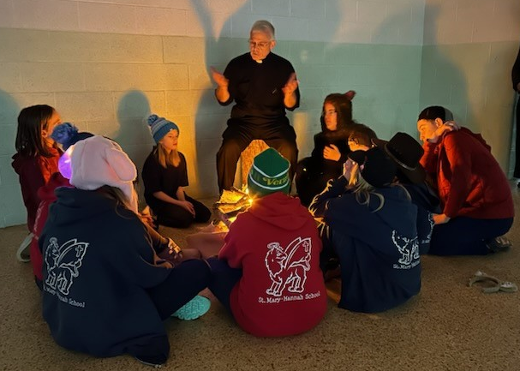
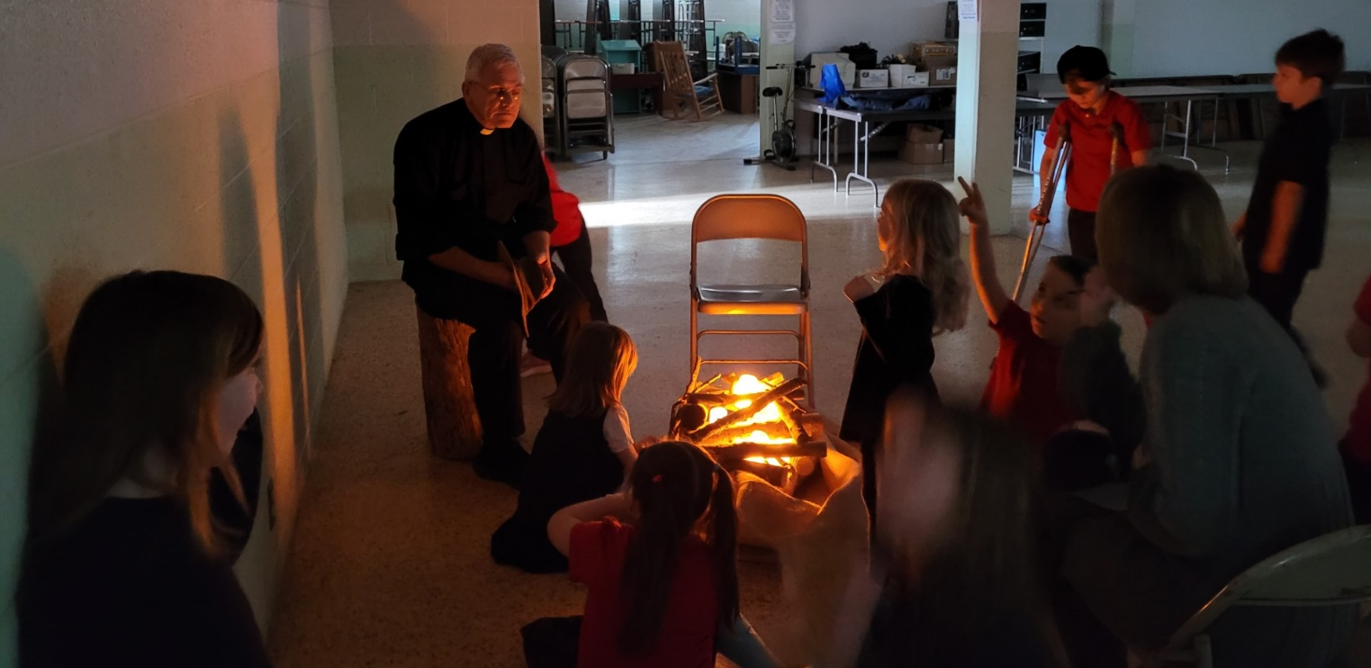
Campfire with Fr. Joe!

Slide 9
There was stiff competition at the Catechism Bee!

Slide 10
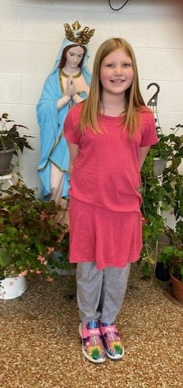
And the winners are…
First Place – Adelina
Second Place – Gabe
Third Place – Maple
Good work to all who participated in this year’s bee.
Congratulations to you, Adelina!

Slide 11
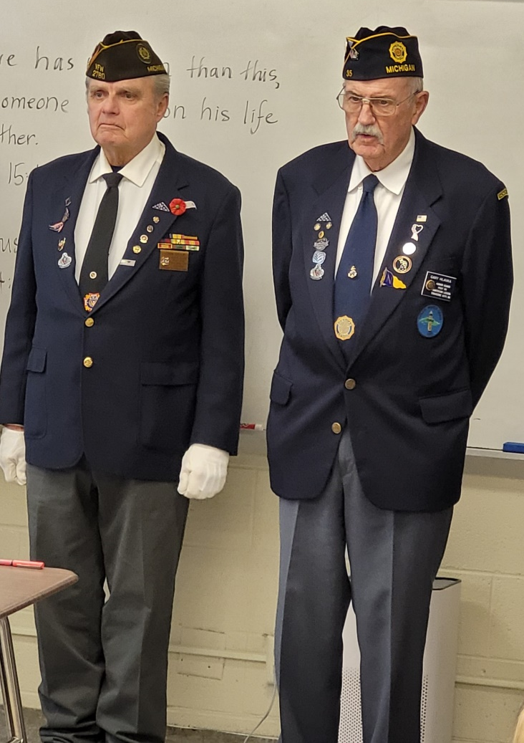
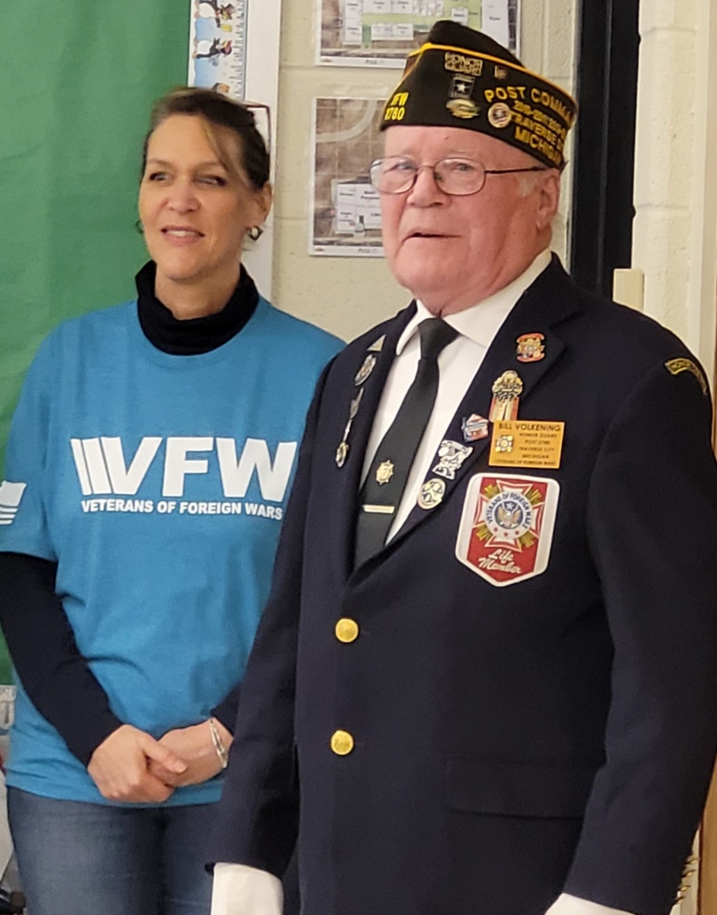
Honoring our Nation’s Soldiers & Veterans

Slide 12
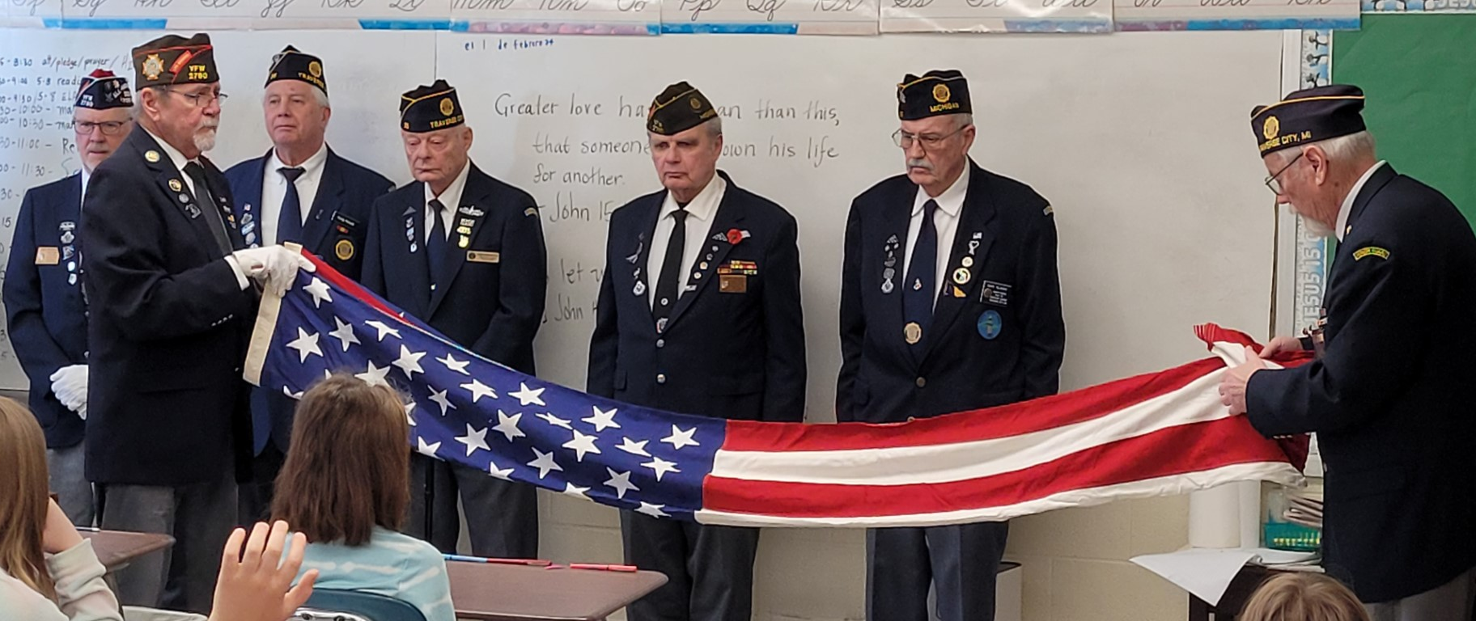
Respect for our Flag

Slide 13
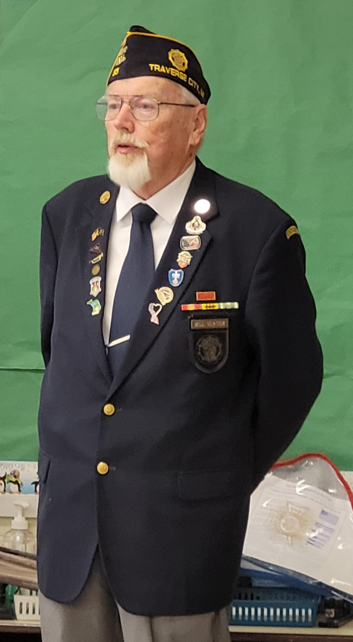
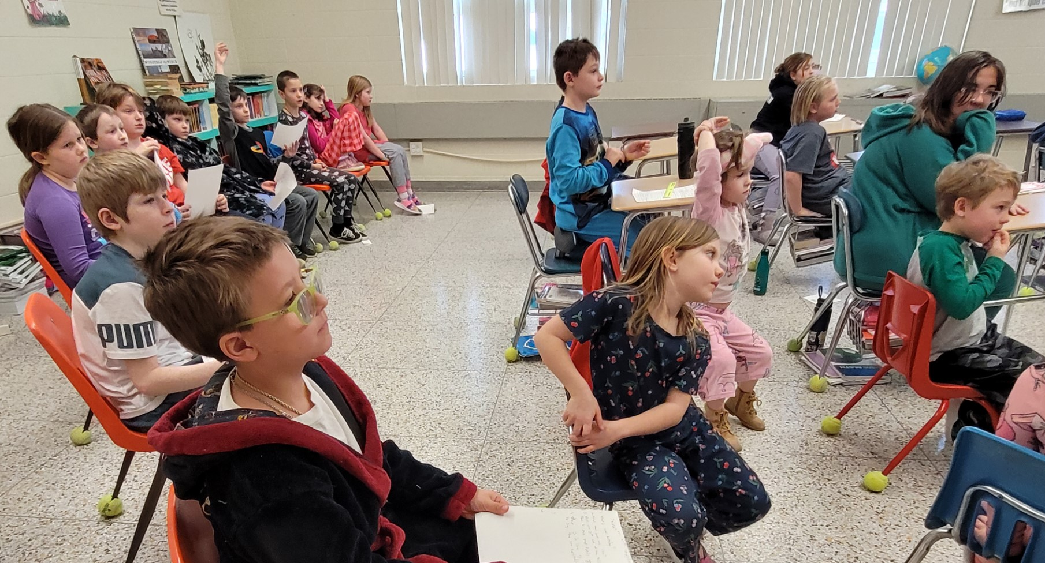
Questions for our Veterans

Slide 14
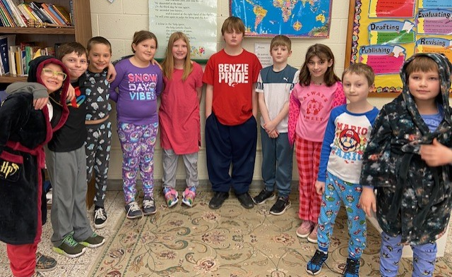
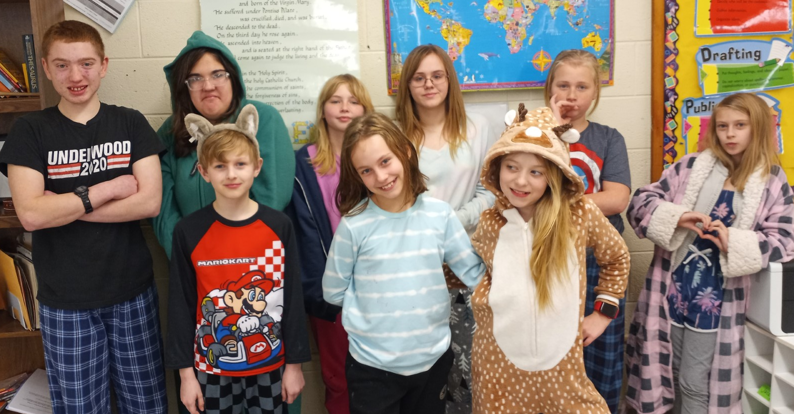
Pajama Day!

Slide 15
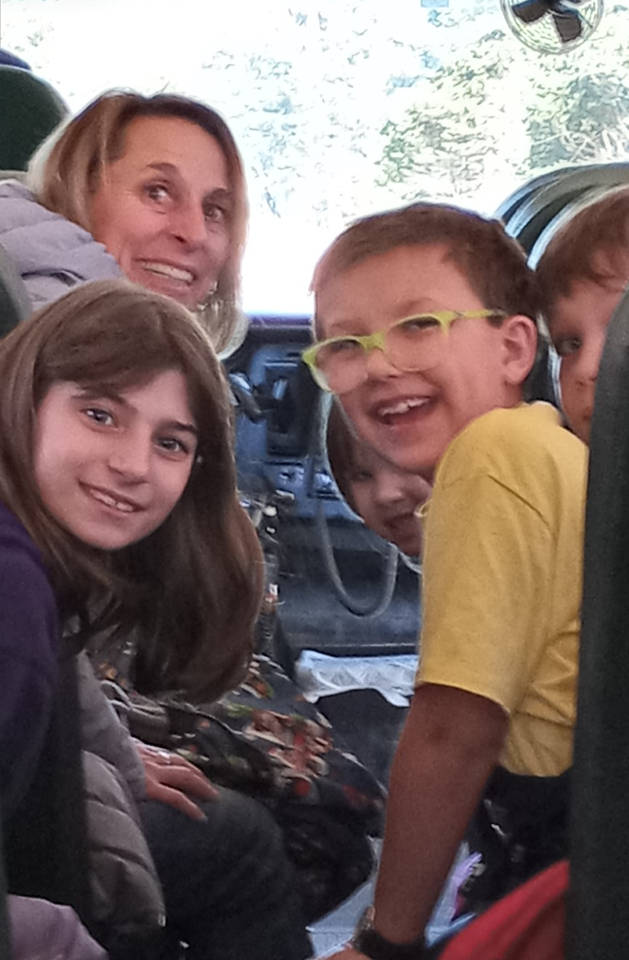
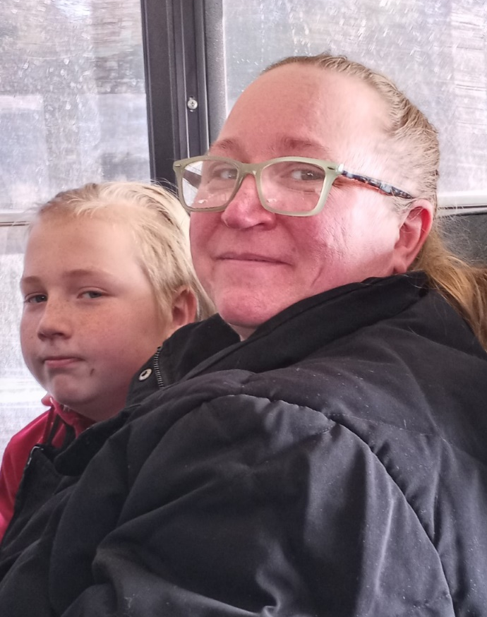
Excited faces!

Slide 16
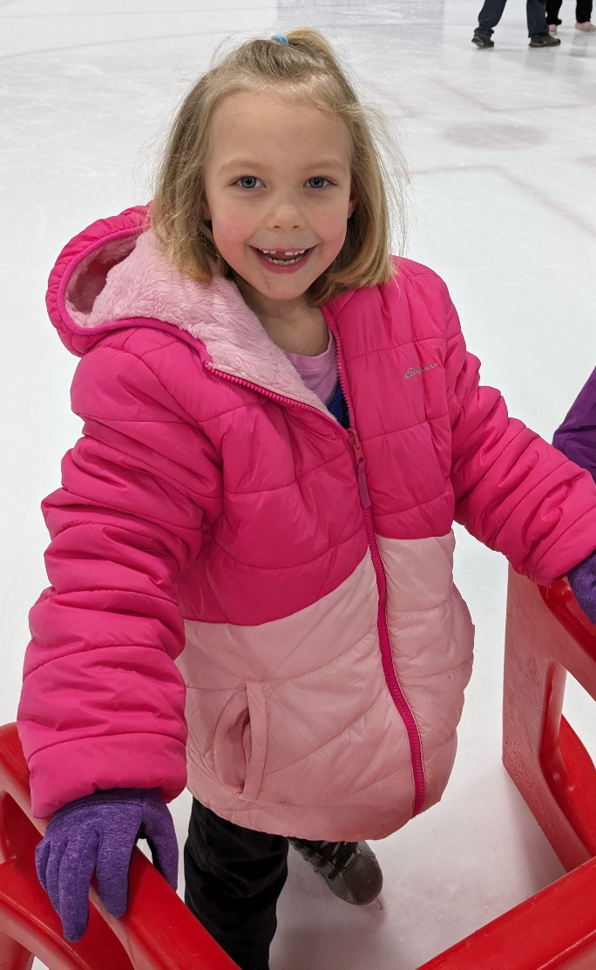
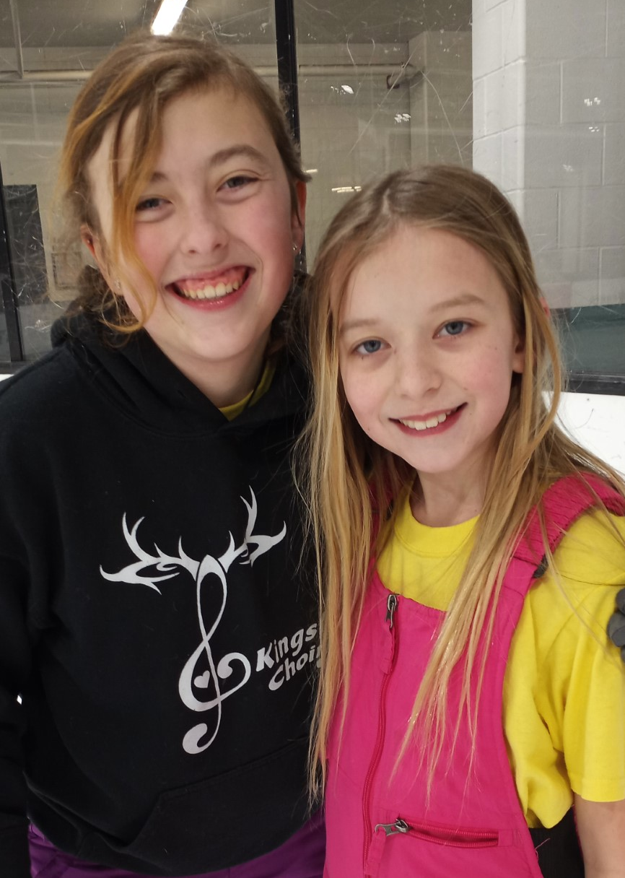
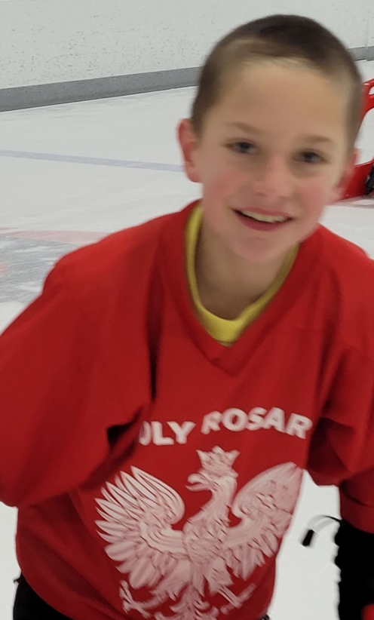
Skating FUN at Centre Ice!

Slide 17
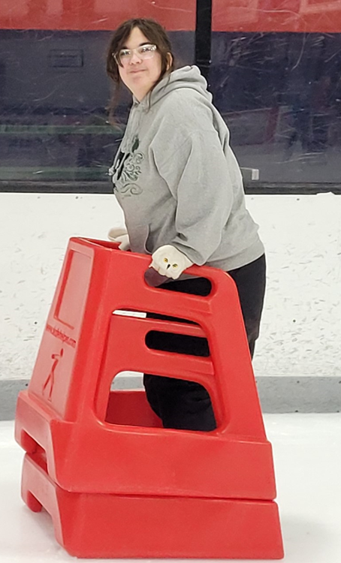

Slide 18
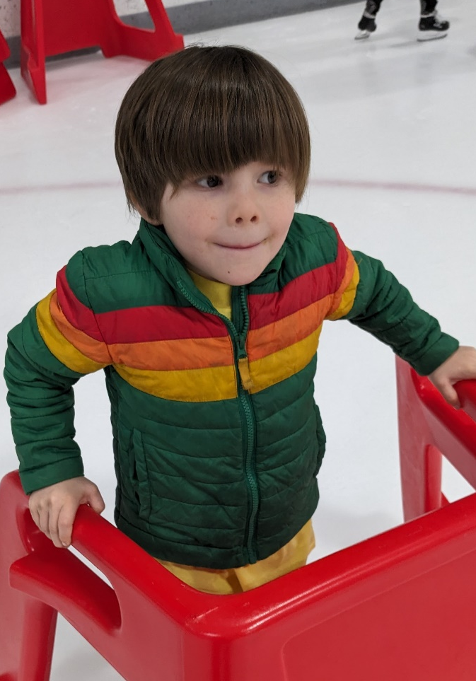
New Skaters!

Slide 19
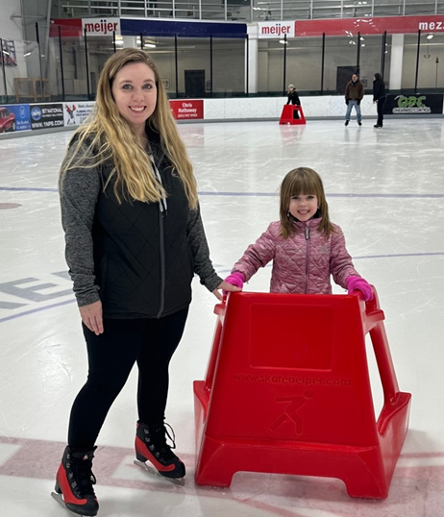
Family FUN!

Slide 20
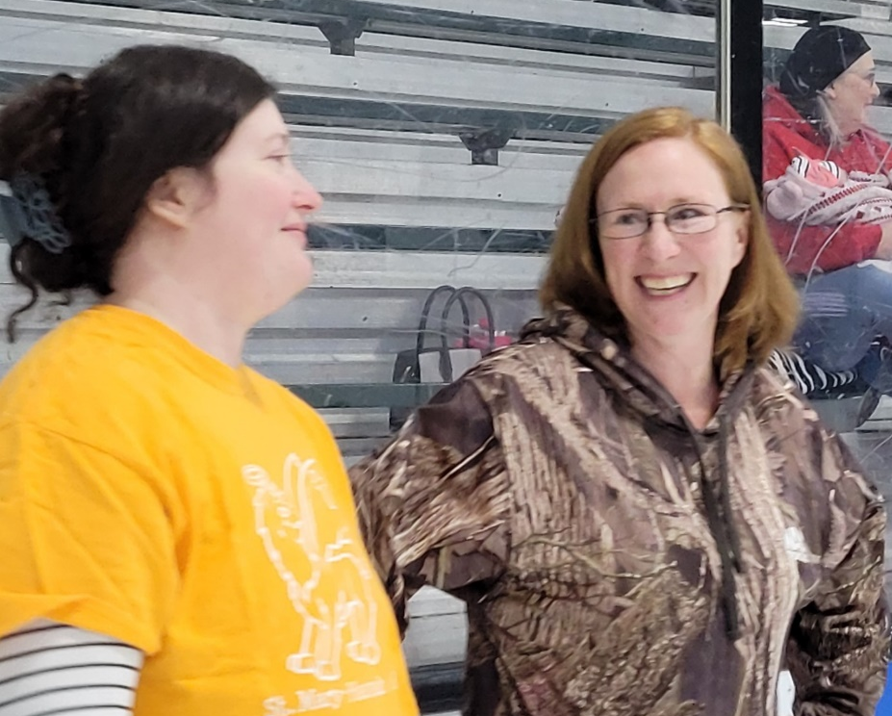

Slide 21
Gliding along!

Slide 23
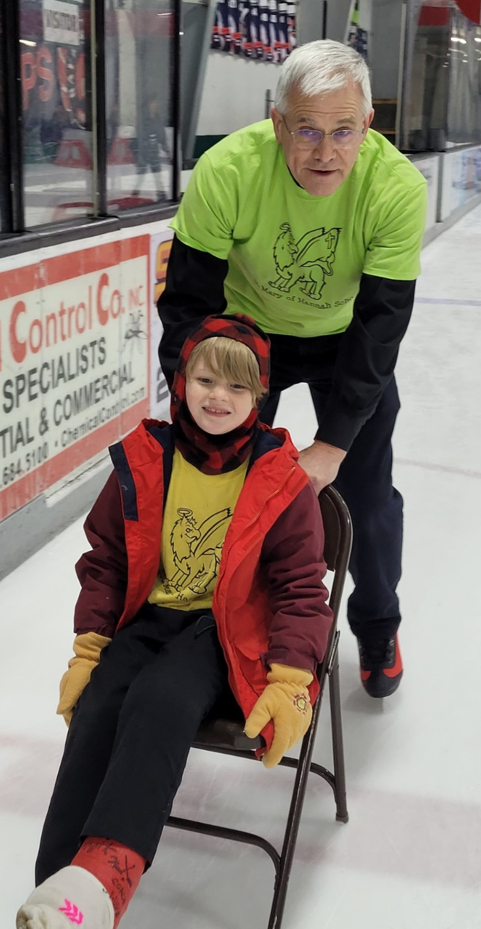
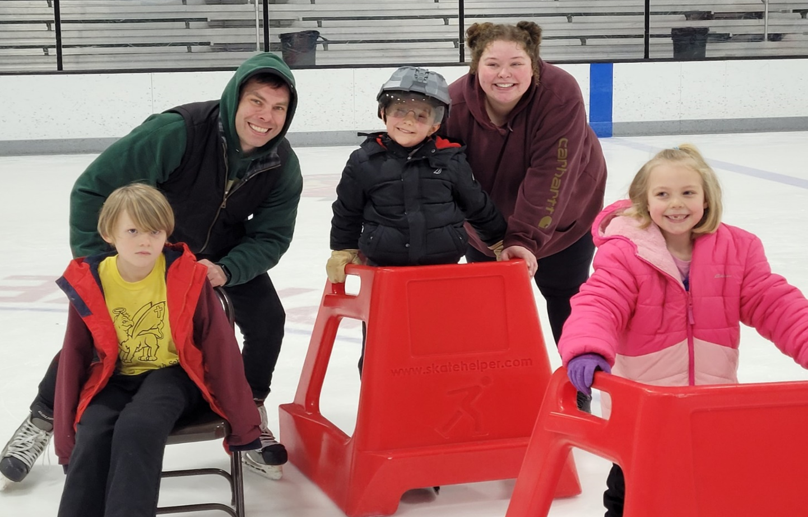

Slide 24
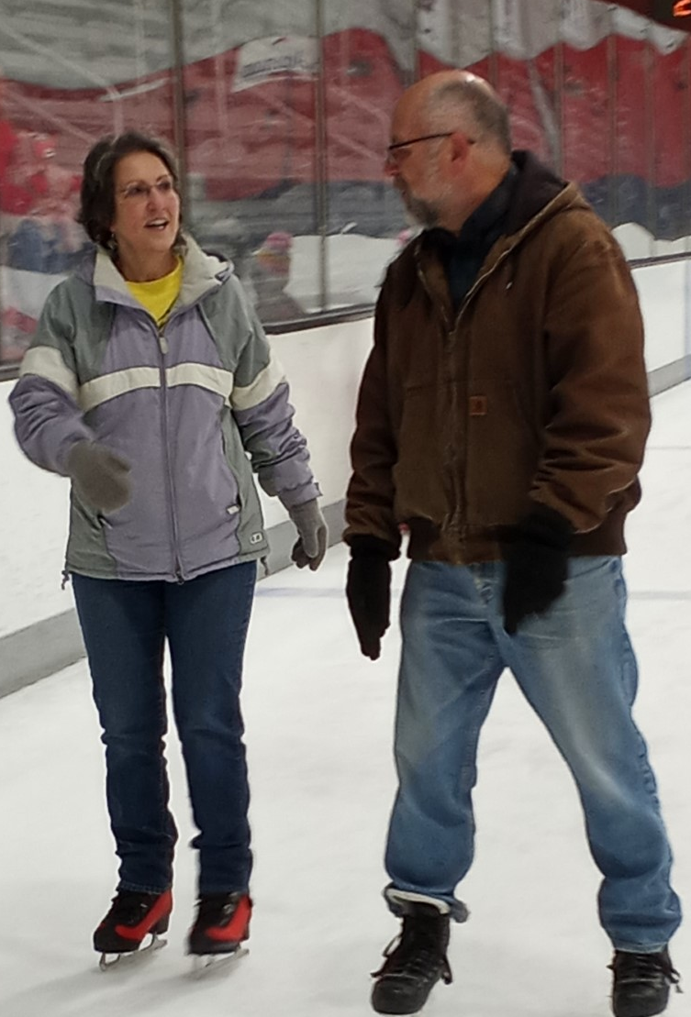
Look who came to skate!!!

Slide 25
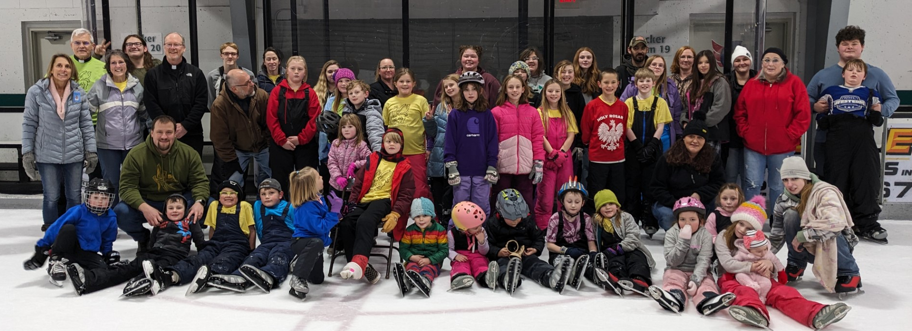

Slide 27
A special thanks to everyone who supports us and helped make our Catholic Schools Week celebration so much fun!!!!

